Slide 1
MSE in Data Science at CAI of ZHAW
Machine Perception and Cognition Group
Application of Marco Betschart
29th of April 2025

Slide 2
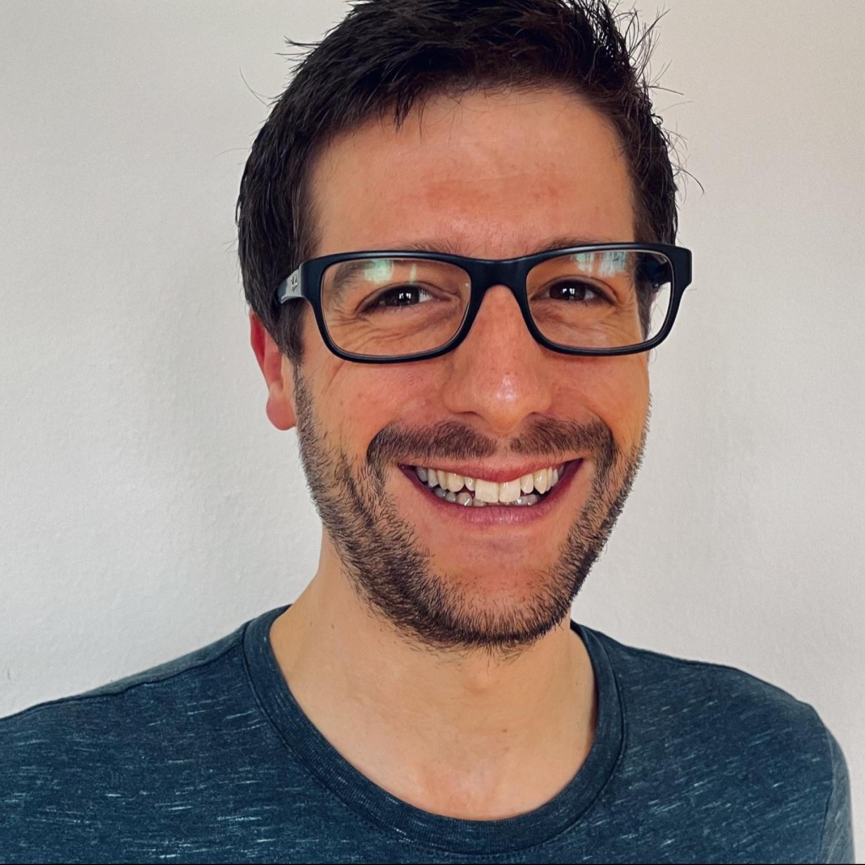
About Me
36 years old
Software Developer since 2004
Climbing is a hobby of mine
Live in Zurich, grown up in Schlatt (TG)

Slide 3
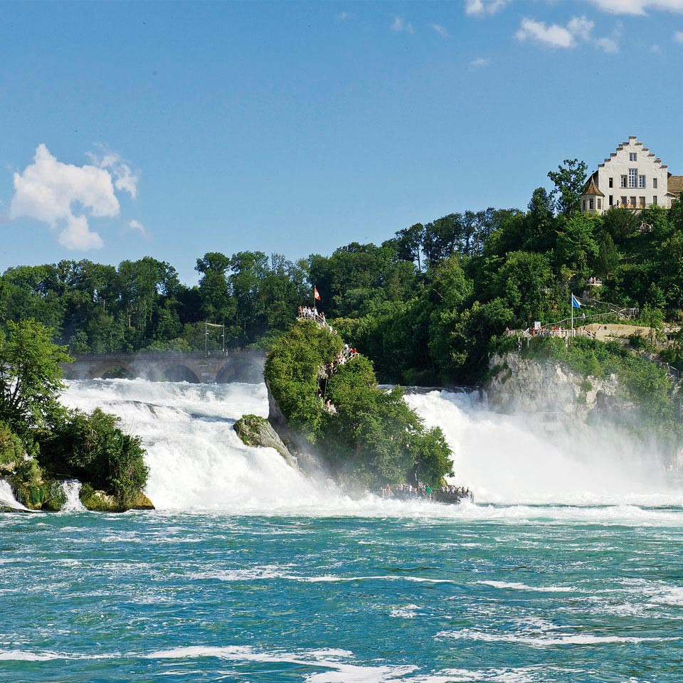
About Me
36 years old
Software Developer since 2004
Climbing is a hobby of mine
Live in Zurich, grown up in Schlatt (TG)

Slide 4

Floppy Disk configured as A: drive
Done processing startup files C:\FDCONFIG.SYS and C:\FDAUTO.BAT
Type HELP to get support on commands and navigation.
Welcome to the MS-DOS operation system
C:\>

Slide 5
Floppy Disk configured as A: drive
Done processing startup files C:\FDCONFIG.SYS and C:\FDAUTO.BAT
Type HELP to get support on commands and navigation.
Welcome to the MS-DOS operation system
C:\>
asjdf
asjdf: Command not found
C:\>

Slide 6
Floppy Disk configured as A: drive
Done processing startup files C:\FDCONFIG.SYS and C:\FDAUTO.BAT
Type HELP to get support on commands and navigation.
Welcome to the MS-DOS operation system
C:\>
asjdf
asjdf: Command not found
C:\>
start-apprenticeship.bat
Starting with Web Development in 2004...

Slide 7

Software Developer
Programming Languages
Java, Kotlin, Swift, Python, PHP, JavaScript+HTML+CSS, ...
Platforms
Spring Boot, Docker, WordPress, Android, iOS, ...
Infrastructure
Services
Web, Mail, DNS, Databases, …
Operating Systems
Linux, Windows Server, macOS, iOS, Android

Slide 8
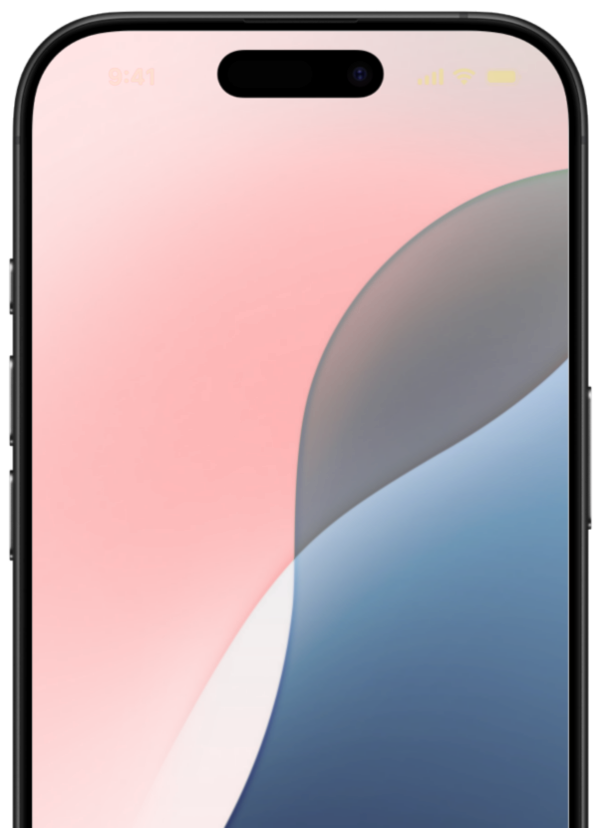

Software Developer
Programming Languages
Java, Kotlin, Swift, Python, PHP, JavaScript+HTML+CSS, ...
Platforms
Spring Boot, Docker, WordPress, Android, iOS, ...
Infrastructure
Services
Web, Mail, DNS, Databases, …
Operating Systems
Linux, Windows Server, macOS, iOS, Android

Slide 9

BSc in Computer Science
Machine Learning and Data Mining
Artificial Intelligence 1+2
Visual Computing 1+2
Top grade in Bachelor Thesis
"XR as a tool in the selection process
of task force candidates"

Slide 10

Precious Metal Industry Platform
"Connecting and digitalizing the precious metal industry"
Distributed platform with standardized taxonomy for precious metal industry data

Slide 11
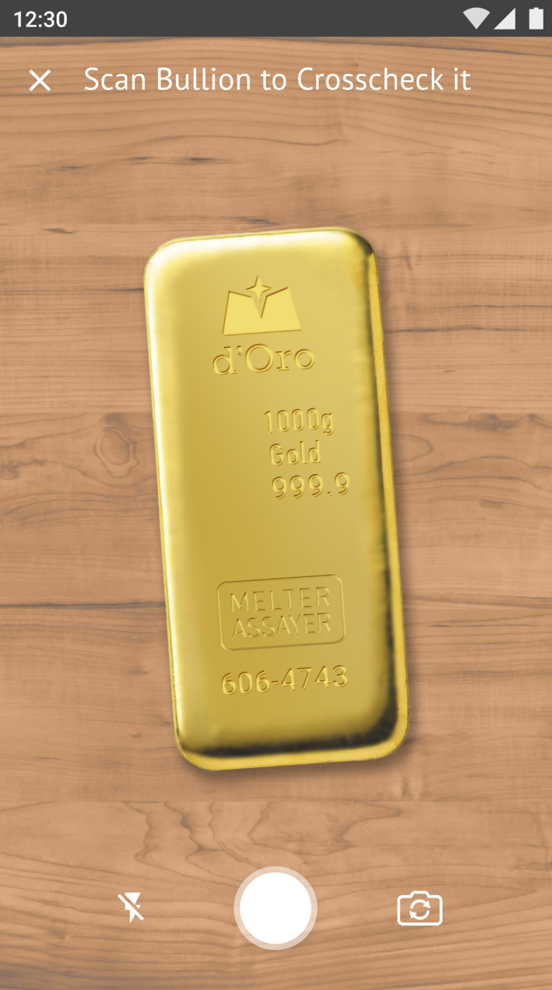

Bullion Scanning App
Recognize Values
Brand, Format, Metal, Fineness, Serial Number
Supervised Learning
5000 images with their labels
Challenges
Hardware, Connectivity, Exotic Bullions, Cost Efficiency

Slide 12
Motivation
Industry
AI Competence Center
aXedras AG
Research
Next-Level AI
CAI at ZHAW

Slide 13
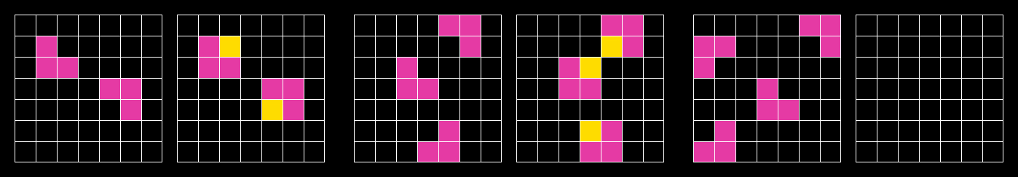


Complex Problem Solving
Engineered with core knowledge priors in mind
Model must be capable to solve novel challenges (secret evaluation set)

Slide 14
Complex Problem Solving
Method
Regression, SVM, Search + DSL, CNNs, Transformers, ….
Tools
Tensor Flow, PyTorch, Numpy, ...
Existing Solutions
What did work? What didn’t?
Constraints
Resources, Runtime, Network

Slide 15
Complex Problem Solving
Method → Biggest Unknown
Tools
Tensor Flow, PyTorch, Numpy, ...
Existing Solutions
CNN seems to be promising
Constraints
Resources, Runtime, Network

Slide 16
Complex Problem Solving
Neural-guided Program Search, 2021
A Path Towards Autonomous ML, 2022
Principles of Parsimony, 2022
Attention Is All You Need, 2023
KAN: Kolmogorov-Arnold Networks, 2024
1-bit LLMs, 2024
...
Alpha Signal
Data Machina
The Batch

Slide 17

Complex Problem Solving
Establish Test Baseline
Using a simple LinearModel
Build Environment for Experiments
We want to run different experiments quickly

Slide 18

Complex Problem Solving
Neuroscience
Nature solved the problem already!

Slide 19
ARC Challenge
Divide and Conquer
Research
Explore the
Problem
Proof
of
Concept
Implement
Full
Solution
End

Slide 20
Thank You
Questions?

